Slide 1

/RENEWABLE ENERGY DEVELOPMENT SCENARIOS
Project of Computer Engineering
Cogollo Alessandro
INDEX.HTML

Slide 2
/OBJECTIVES
/SUPPORTING RENEWABLE DEVELOPMENT SCENARIOS
/COMPUTING PHOTOVOLTAIC DISTRIBUTION AND PRODUCTION VALUES
/INTERACTIVE WEB APPLICATION
integrated in the RSE dissemination platforms
OBJECTIVES.HTML

Slide 3
<PYTHON>
provides a broad variety of libraries very well suited to develop custom applications in the field of geospatial analysis
SPECIFICATIONS.HTML

Slide 4
/SPECIFICATIONS
/PANDAS
/PSYCOPG2
/FLASK
/BOOTSTRAP
flexible library to operate with datas
powerful tool to interrogate the database
web framework with an easy-to-extend philosophy
and some jQuery, in
addiction to vanilla javascript
SPECIFICATIONS.HTML

Slide 5
/SPECIFICATIONS
/FOLIUM
builds on the data wrangling strengths of the Python ecosystem and the mapping strengths of the leaflet.js library.
SPECIFICATIONS.HTML

Slide 6
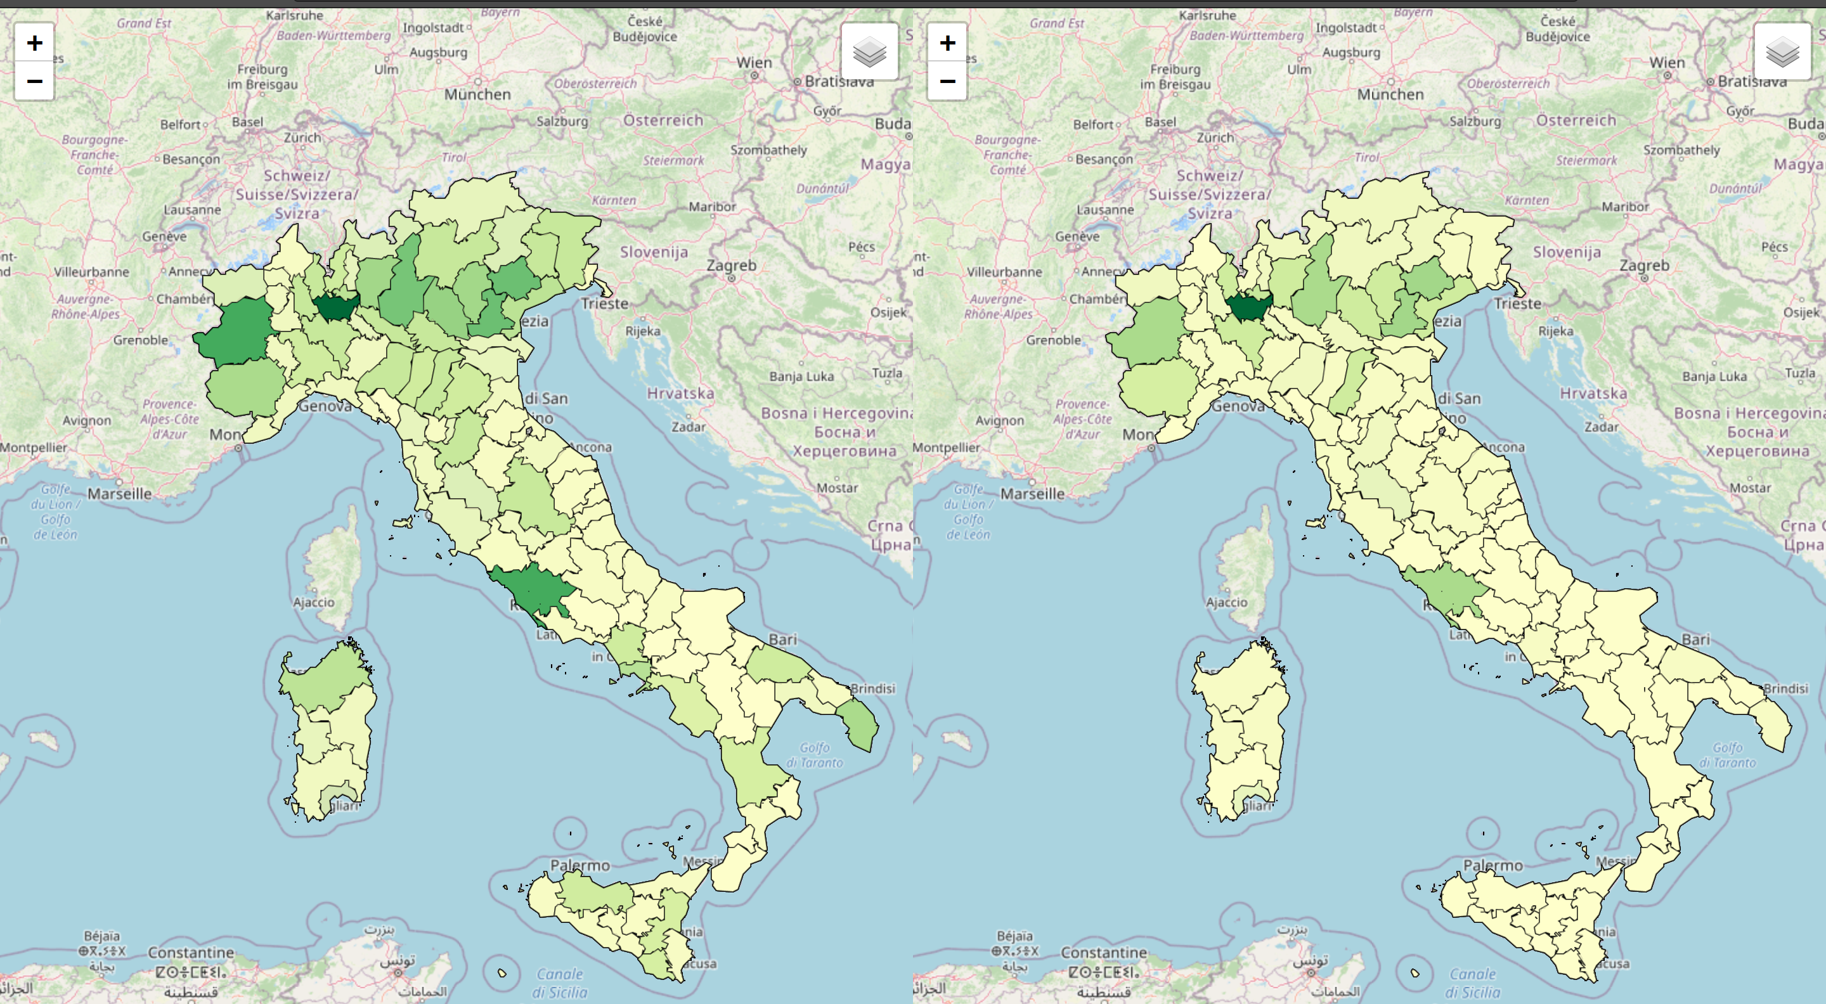
/FEATURES
the developed web app permits to plot and compare map plots based on parameters submitted by the user; output values can be inspected at a province scale thanks to a tooltip that is triggered and showed on mouse over event.
FEATURES.HTML

Slide 7
/ARCHITECTURE
/WEB SERVER
dispatches requests and returns responses
/CLIENT
sends requests to WEB server
/GRAPH SERVER
/COMPUTATIONAL SERVER
/plots graphs and maps
queries the
database. Obtains input values
ARCHITECTURE.HTML

Slide 8
/FLOW
client
web server
graph server
computational server
database
1
2
/1
/2
3
4
client requests /create/
web server responds /create/
5
6
8
7
9
10
sequence diagram of map plotting
/3
/4
client submits params form
web server pass params
INDEX.HTML

Slide 9
/FLOW
#7e3bbe
client
web server
graph server
computational server
database
1
2
/5
/6
3
4
graph server init orch
asks database for datas
5
6
8
7
9
10
sequence diagram of map plotting
/7/8/9/10
sending requests to client
INDEX.HTML

Slide 10
/DATAS
abstract schema of db tables
Variables | Arable Land | Agricultural Added Value
 | Built Surface | Domestic Consumption
 | Province Population | Taxable Income Per Capita
Hourly Producibility | Hourly Producibility
Photovoltaic Installed | Installed Power Land | Installed Power Roof
DATAS.HTML

Slide 11
/PARAMETERS
/SCENARIO PV POWER
/INSTALLED POWER ROOF
/PV OCCUP. COEFFICIENT TARGET ROOF
/PV OCCUP. COEFFICIENT BASE ROOF
/PV DENSITY TARGET LAND
/WEIGHTS
Goals [52000MV]
Goals [40%]
Coefficients [0,005 km2/MW]
Coefficients
[90,9 MW/km2]
No unit
Coefficients [0,008 km2/MW]
PARAMETERS.HTML

Slide 12
/PARAMETERS
/SCENARIO PV POWER
/INSTALLED POWER ROOF
/PV OCCUP. COEFFICIENT TARGET ROOF
/PV OCCUP. COEFFICIENT BASE ROOF
/PV DENSITY TARGET LAND
/WEIGHTS
Goals [52000MV]
Goals [40%]
Coefficients [0,005 km2/MW]
Coefficients
[90,9 MW/km2]
No unit
Coefficients [0,008 km2/MW]
PARAMETERS.HTML

Slide 13
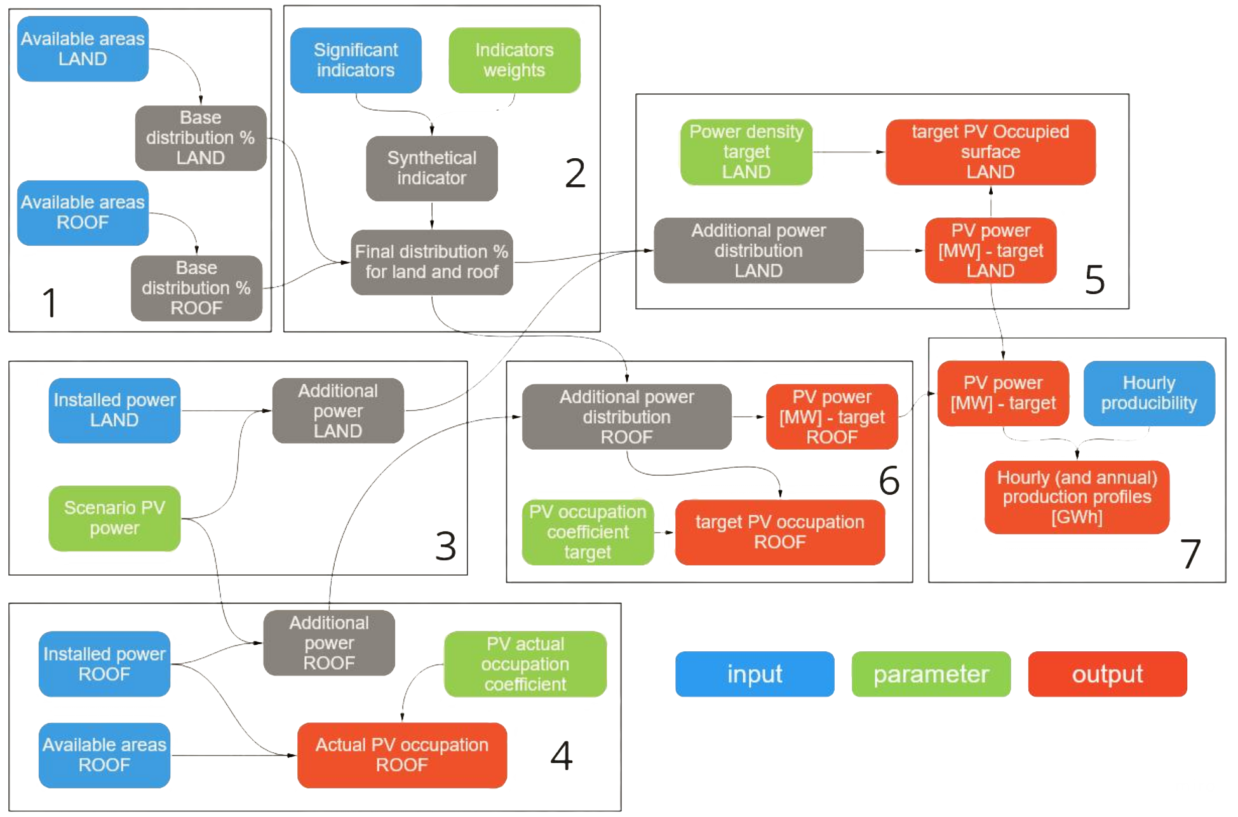
/FORMULAS
FORMULAS.HTML

Slide 14
/COMPONENTS
/ARITHMETIC
MODULE
/COMPUTATIONAL MODULE
/OUTPUT VALUES MODULE
THANKS.HTML

Slide 15
<THANKS!>
THANKS.HTML

